Slide 2
TRANSNATIONAL MOBILITY OF STAFF – IMPACT ON LITHUANIAN SCHOOLS
Evidence-based Policy in Erasmus+
Seminar on research and methodology
Warsaw, October 25-27, 2017
Liutauras Ivoška

Slide 3
Impact and Sustainability of the Erasmus+ Programme Key Action 1 (KA1) Mobility Projects for School Education Staff
Lithuania
Estonia
Finland
Poland
Germany

Slide 4
Impact and Sustainability of the Erasmus+ Programme Key Action 1 (KA1) Mobility Projects for School Education Staff
Reasons of the reasearch:
A new strategic approach introduced in the ERASMUS+;
A significant increase of the grant amount per school;
Introduction of the consortium model from 2015.
Aim of the reasearch:
To evaluate the impact and sustainability of the ERASMUS+ KA1 Mobility Projects for School Education Staff.

Slide 5
Organisation of the research
TCA partners:
Estonia, Finland, Germany, Lithuania and Poland.
Period of the TCA:
From January, 2016 to June, 2017.
The scope of the research:
Projects funded under the Calls for proposals 2014 and some selected projects from the year 2015.
Research approach:
Leading experts (LT) developed the methodology and research instruments. National experts (EE, FI, DE and PL) carried out the research using the same methodology and research instruments to ensure comparability.

Slide 6
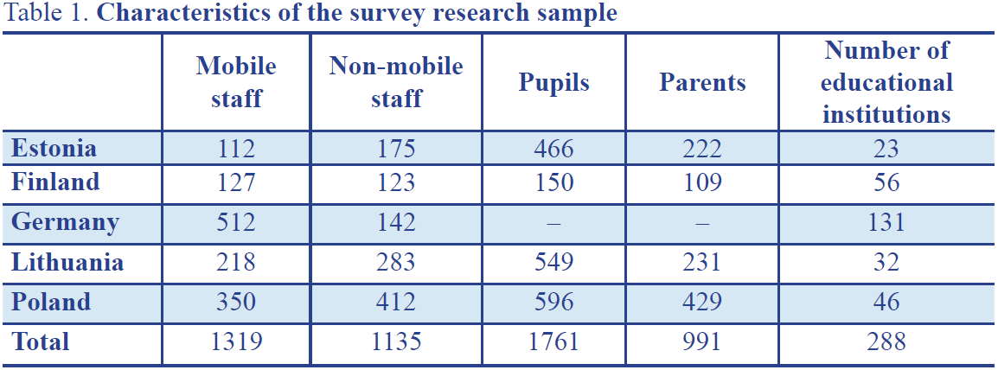
Research methods
Quantitative research methods:
On-line survey for mobile staff¹, non-mobile staff², pupils (15 years and older), parents³.
¹ Mobile staff – teachers, school administration, and other school staff who participated in the ERASMUS+ KA1 mobility
² Non-mobile staff – teachers, school administration, and other school staff who did not participate in the ERASMUS+ KA1 mobility
³ Pupils’ and parents’ survey was not performed in Germany

Slide 7
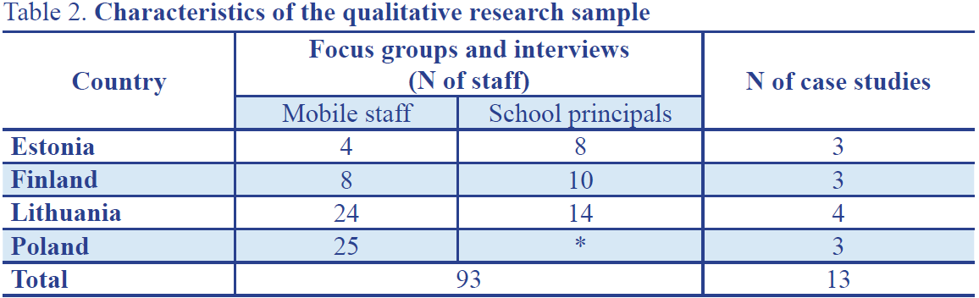
Research methods
Qualitative research methods:
Focus groups with mobile staff and principals of granted schools;
Case studies: interviews with leaders of granted schools (consortiums); focus groups with mobile staff, non-mobile staff; analysis of strategic documents of granted schools;
Data analysis methods: descriptive and inferential statistics, path analysis methods, descriptive qualitative analysis.
* together with teachers

Slide 8
Impact and Sustainability of the Erasmus+ Programme Key Action 1 Mobility Projects for School Education Staff
Lithuania
Estonia
Finland
Poland
Germany

Slide 9
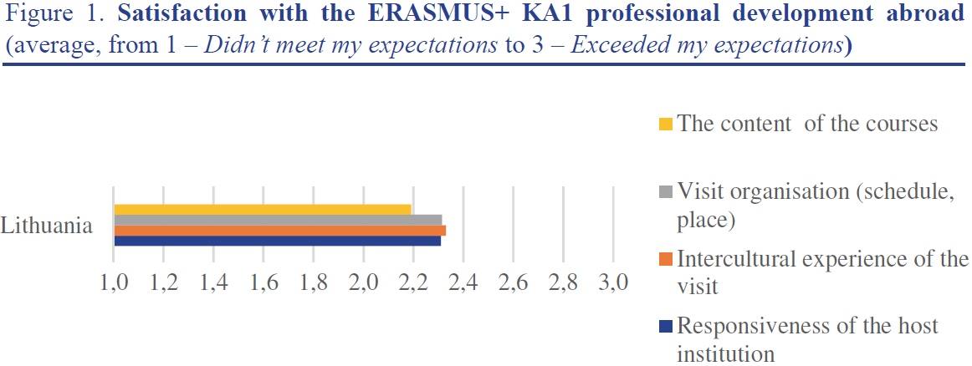
The main highlights of the research
What is the general evaluation of the ERASMUS+ KA1 Mobility Projects for School Education Staff?

Slide 10
The main highlights of the research
What impact does the ERASMUS+ KA1 staff mobility have on a teacher?

Slide 11
The main highlights of the research
What impact does the ERASMUS+ KA1 staff mobility has on a school?

Slide 12
The main highlights of the research
What factors support teacher professional development and school change?
Figure 7. Leadership activities taken by mobile staff after the ERASMUS+ KA1
professional development abroad.

Slide 13
The main highlights of the research
Do pupils notice any change in the class?
Figure 11. What is the behavior of your teachers after they return from the training activities abroad? Pupils’ survey data. Percentages of answers strongly agree and somewhat agree

Slide 14
The main highlights of the research
Do pupils notice any change in the class?
Figure 12. Pupils’ expectations for teacher and school internationality. Percentages of answers strongly agree and somewhat agree

Slide 15
The main highlights of the research
Do colleagues at school notice the changes?

Slide 16
Impact and Sustainability of the Erasmus+ Programme Key Action 1 (KA1) Mobility Projects for School Education Staff
Lithuania
Estonia
Finland
Poland
Germany

Slide 17
Conclusions (1/3):
High satisfaction with professional development. Some criticism about the content of mobility;
High satisfaction with the support from NA, comments on the complexity of application form;
The increased teacher openness to teaching innovations;
Contribution of the ERASMUS+ KA1 mobility to the implementation of the school strategy;
The highest perceived change – school culture. The perceived change on pupil learning results is less emphasized.

Slide 18
Conclusions (2/3):
A significant success factor is a thorough preparation for the mobility;
The dependence of changes in teacher competencies on the form of professional development;
The significance of teacher leadership for sustainability of project results;
Dissemination – an important but not a sufficient factor for sustainability of project outcomes;
The significance of supportive school environment for the project outcomes.

Slide 19
Conclusions (3/3):
The importance of school principal’s role for project sustainability;
Changes in teacher behavior are noticed by pupils;
Pupils’ high expectations for teachers’ competencies in terms of internationality;
Recognition of mobile teachers’ leadership;
Positive parents’ attitudes towards school’s internationality and teacher professional development abroad.

Slide 20
Recommendations (1/2)
For the EC and NAs:
There should be a space for teachers to provide feedback on the quality of courses (both good and bad practices). The tool should be freely accessible online. A rating system of course providers should be considered;
Schools should be encouraged to put more emphasis on developing pupil-oriented practices and indicators for measuring the impact of the project;
During the process of evaluation of applications <…> priority should be given to more proactive experience sharing forms (professional workshops, labs, and other forms of collaborative working activities);
Project application form could include the information about preparation activities that have already been implemented in school before submitting the application;
The focus of NA initiated events, courses, and seminars for the applicants should be not only information oriented but be more focused on the development of strategic thinking and project competency development;
The promotional materials/activities using ICT technologies could be prepared for introducing the ERASMUS+ to wider school audiences (parents, pupils).

Slide 21
Recommendations (2/2)
For municipality-level politicians and administrators of education:
If the follow-up studies were to be conducted it is recommended to initiate them after a reasonable period, e.g. 1–2 years after the project completion;
For administrators of the municipalities where ERASMUS+ KA1 projects were implemented on the consortium model, it is recommended to monitor the impact of the project on the local/regional environment and create favorable conditions for joining into experience sharing activities.
For school managers and teachers:
The aspects of the impact and sustainability of an ERASMUS+ KA1 project <…> should be analysed and assessed as part of school self-assessment (finding the links between the aims reached by the project and school performance indicators);
If the language is an obstacle for professional development abroad, schools could use part of the organisational lump-sum for language development skills;
It is recommended to choose the combination of different forms of mobility – <…> courses aligned with more practical forms, like job shadowing and teaching;
The engagement of school principal in all project stages is highly recommended for the ensurance of the effectiveness and sustainability of project results.

Slide 22
Dissemination and exploitation of the results
Results:
5 national research reports (NRRs);
1 (joint) transnational research report (TRR).
Publications:
FI NA: a dedicated “Facts express” publication, infographics;
LT NA: two Short National Research Papers (“Problem Analysis in Education”): “How teacher training abroad strengthens teachers’ leadership” and “Strengthening the school’s transnational dimension through teacher training abroad projects”;
PL NA: an article in a quarterly educational journal “Europe for Actives”; a printed version of the NRR.
Websites:
All NAs.
Oth.:
part of the mid-term evaluation of the ERASMUS+, presentation of the TRR in the Sectorial EC Meeting, presentation of the NRR and TRR to the national authority and stakeholders (LT NA), mailing lists (FI NA), info/training sessions.

Slide 23
Dissemination and exploitation of the results (NRRs)
DE NA: https://www.kmk-pad.org/index.php?id=626
(direct link to the NRR in German https://www.kmk-pad.org/fileadmin/Dateien/download/vf/TCA/Abschlussbericht_Erasmus__Evaluation_Leitaktion_1.pdf);
EE NA: http://archimedes.ee/infomaterjal/uuringud-ja-ulevaated/
(direct link to the NRR in English http://archimedes.ee/wp-content/uploads/2017/01/%C3%95pir%C3%A4nde-m%C3%B5ju_l%C3%B5ppversioon.pdf);
FI NA: http://www.cimo.fi/ohjelmat/erasmusplus/yleissivistavalle_koulutukselle/avaintoimi_1_liikkuvuus
(direct link to the NRR in English: http://www.cimo.fi/instancedata/prime_product_julkaisu/cimo/embeds/cimowwwstructure/111811_National_Report_Finland_FINAL.pdf;
LT NA: http://erasmus-plius.lt/puslapis/erasmus-mobilumo-mokymosi-tikslais-projektu-statistika-177
(direct link to the NRR in English: http://erasmus-plius.lt/uploads/files/2015-12-18i-national-report.pdf);
PL NA: http://czytelnia.frse.org.pl/1542/
(direct link to the NRR in English http://czytelnia.frse.org.pl/media/frse-raport-nauczyciele-ENG-2017-01-04-a_VZ9jBQM.pdf).

Slide 24
Dissemination and exploitation of the results (TRR)
TRR (in English): http://erasmus-plius.lt/uploads/files/impact-sustainability-of-the-erasmus-programme-ka1-mobility-projects-for-school-education-staff.pdf
TRR in brief (in English): http://erasmus-plius.lt/uploads/files/impact-sustainability-of-the-erasmus-programme-ka1-mobility-projects-for-school-education-staffreport-in-brief.pdf.

Slide 25
Follow-up of the research:
Longitudinal research;
Updated methodology and research instruments to ensure comparability;
Evaluation of the sustainability of the results (i.e. same schools).
TCA partners:
Estonia, Finland, Germany, Lithuania and Poland.
Period of the TCA:
From January to December, 2018.

Slide 26
Thank you
Dziękuję

