Slide 1
Analysis of the Impact, Valorization and Sustainability of KA2 Strategic Partnerships for Innovation Erasmus+ and the Innovative Challenge for International Cooperation
Angela Miniati
a.miniati@indire.it
Study and Analysis Unit
Erasmus+ National Agency Indire

Slide 2
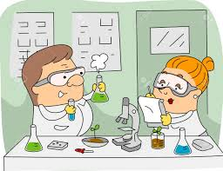
Studies and Analysis Unit
Interesting!
What do we do? We analize!
Analysis of the impact and valorization of results
Erasmus+ Evidence-based analysis
Survey on the impact of KA1 and KA2
Cooperation with other offices in NA
Qualititative monitoring of the impact

Slide 3
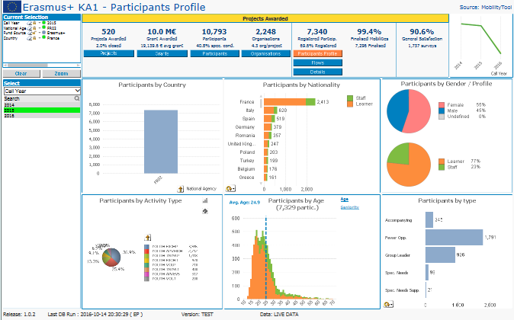
Who are we?
The Studies and Analysis Unit is responsible for monitoring and analyzing the overall impact of Erasmus+ KA1 e KA2 decentralized actions in Italy for school, university and adult education sectors. We are 3 persons.
In particular, our unit analyzes the contribution and impact of Erasmus+ on beneficiaries, institutions and the overall education system. We edit reports and publications addressed to the school, university and adult sector.

Slide 4
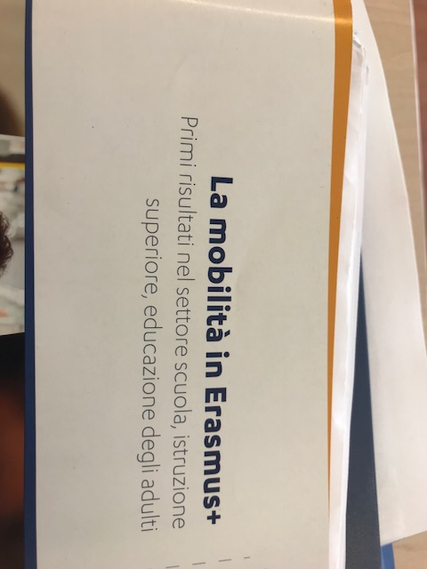
Our Surveys on the impact of Erasmus+ Key actions
2015
Editorial series
‘Mobility in Erasmus+’
First results for School, Higher Education and Adult sector, n. 1
An Analysis of the first KA1 Mobility Projects (1 year duration) carried out in 2015, based on Participant Reports in Epluslink, Mobility Tool, Focus Groups and Case studies

Slide 5
2016
Editorial series
‘Analysis of Impact, valorization and Sustainability of KA2 Strategic Partnerships for Innovation’, n. 2
CALL 2014
An qualitative analysis of the impact at individual, institutional, systemic level of
the KA2 for innovation (large scale) for the three sectors of education. First ended
projects (2/3 years duration)
School sector
University sector Adult sector

Slide 6
Objectives and Methodology of the Study
The survey is focused on the changes occurred at individual, institutional and system levels for the areas of competence, namely school education, higher education and adult education
1. Questionnaire
2. Impact visit: inside the projects process
3. Focus group as peer discussion
Pubblication
We are here: pubblication!

Slide 7
Methodology Design
3 Steps Investigation within KA2 Strategic Partnerships for Innovation 1) Selection (only for SE – AE) 2) Questionnaire - Impact Visits 3) Focus groups
Contest CALL 2014
11 cases study on Italian coordinators Action Type: KA2 for Innovation School and Adult sector | 9 cases study on Italian coordinators Action Type: KA2 for innovation University sector
Thematic selection on the total of 31 strategic partnerships funded in 2014
Analysis tools
Questionnaire, Impact visit, Final reports | Questionnaire, Impact visit, Final reports
Objective research Qualitative impact Dissemination Valorisation Sustainability | Objective research Qualitative impact Dissemination Valorisation Sustainability
Peer discussion on the results 3 Focus groups for each sector to discuss together for exchanging exsperiences and sharing methodologies and ideas

Slide 8
Questionnarie focused on the impact at 3 levels
We sent the questionnaire before the visits and during the visits we discussed with italian coordinator and partners aspect related to dissemination, valorization, and sustainaibility.
This method is helpful and funtional to find out and discuss on the strategies (activities, methodologies, initiatives) related to the dissimination , valorization and impact of results
The impact at systemic level is very difficult to attein and analyse and we debated on possible reasons and possible solutions
Individual
Institutional
Systemic

Slide 9
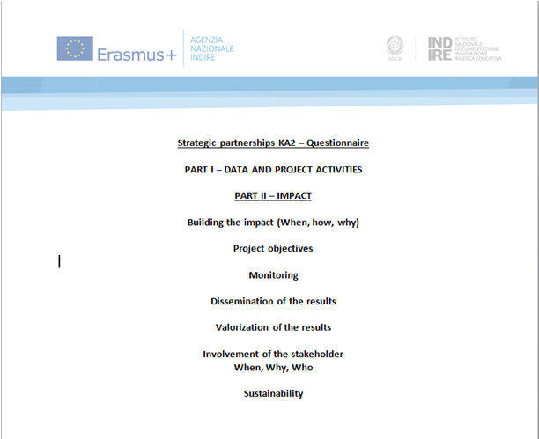
The survey is intended to be a prepatorary activity before the impact visit
the visit is a an informal meeting with the coordinator and partner(s)
The discussion is more flexible and it’s not perceived as a ‘contractual obligation’
The beneficiaries have the chance to reflect on some of the crucial activities and experiences

Slide 10
‘Impact visit’
The visits were have been done during 9 months
11 impact visits carried out for school and adult sector
Main results of survay
The impact is linked to dissemination and valorization plan of the intellectual outpusts
Valorization and trasferibility in other contest
Sustainability in term of benefit and impact of the results after the conclution of the projects
(Long term impact)

Slide 11
Focus group
3 levels research method
Questionnaire
Impac Visit
Focus group
moderated by staff of S&A office
interviews/focus groups
Methodology based on peer discussion and exchange beetween coordinators (SE-HE-AE sector)
The coordinator institutions took part in a around a table discussing together and debating on the main aspects of the dissemination and exploitation of the innovative results (tangible and not tangible)

Slide 12
The results
The results of the “impact visits” and other monitoring activities will be at the core of a publication
Erasmus+ Paper (Quaderno), n° 2, dedicated to case studies on Strategic Partnerships for Innovation, ‘Analysis of the impact, valorisation and sustainability of the results’
The paper publication will be ready at the end of 2018, available in printed and digital version

Slide 13
Thank you for your attention!
Contact us: studieanalisi@indire.it
Virtual visit:
www.erasmusplus.it
www.indire.it

