Slide 1
The index of Higher Education Engagement with the Business Community
Magdalena Jelonek, PhD Mateusz Jeżowski
Notes:
1. geneza projektu (skąd, jakie inspiracje, dlaczego) - Mateusz
2. cel projektu i rozumienie/ definiowanie przez nas najważniejszych pojęć (Mateusz)
3. metodologia projektu i metodyka pracy (ja)
4. finalny model koncepcyjny (ja)
5. model operacyjny (ja - bez prezentowania wskaźników, bo się zanudzą, ale z ogólną informacją na temat tego, jak były konstruowane)
6. dalsze plany (Mateusz)

Slide 2
Agenda
Theoretical - practical and methodological
Research rationale
Research goals
Main definitions
Methodology
Final conceptual model
Further steps
Operational model

Slide 3
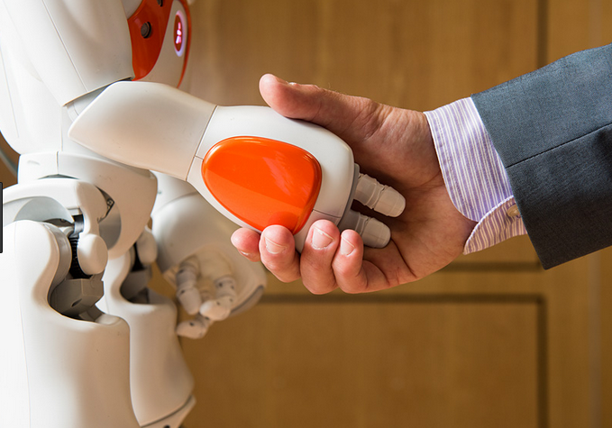
Research rationale
Just as castles provided the source of strength for medieval towns, and factories provided prosperity in the industrial age, universities are the source of strength in the knowledge-based economy of the twenty-first century. Lord Dearing

Slide 4
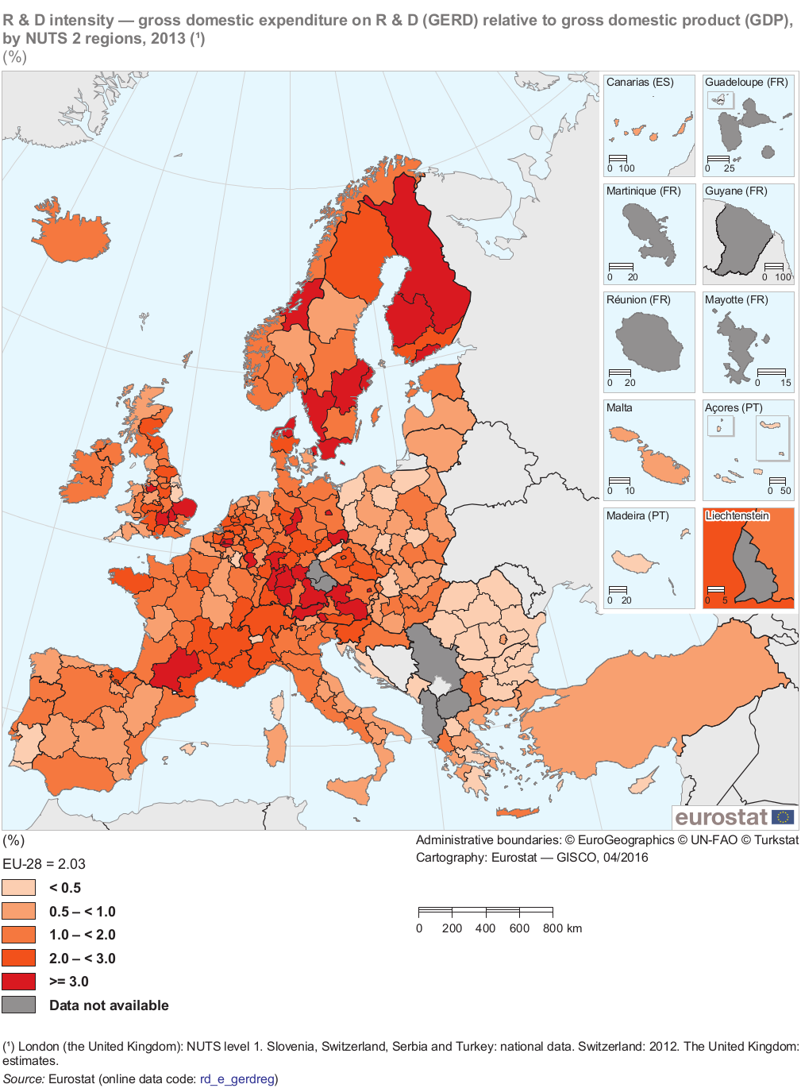

Slide 5
Research goals
illustrate the current situation, highlighting good policy and practice in order to enable informed policy choices;
identify obstacles and drivers of university – business cooperation;
inspire a new policy focus among decision makers by demonstrating the importance of university – business cooperation in stable and prosperous societies.

Slide 6
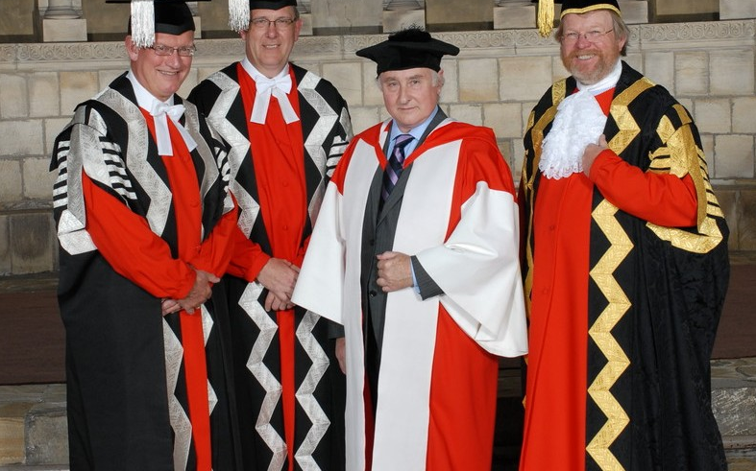
Definitions
University-business cooperation – all interactions, direct and non-direct, on a personal and institutional level between universities and business that bring benefits to both parties interested

Slide 7
Methodology
Conceptual work
(areas of cooperation)
Literature review
IDI – draft model consultations
Operational work
(„draft” indicators and methodology)
Identification of good practices (in the area of UBC monitoring)
Portfolio of indicators
Overview of national data sources (GUS, POLON)
Evaluation of indicators
STEP 1 – PORTFOLIO OF INDICATORS
STEP 2 – METHODOLOGY OF INDEX
FINAL OPPERATIONAL MODEL
Context -
analysis of legal conditions for the cooperation
FINAL MODEL (CONCEPT)
SUGGESTIONS FOR OPPERATIONAL MODEL
Notes:
Central Statistical Office, Integrated Information System on Science and Higher Education

Slide 8
Final model – dimensions
R&D
Mobility (staff and students)
Curriculum development and educational services
Commercial activity
Public engagement

Slide 9
Final model - actions
R&D | Mobility |  | Curriculum development and educational services | Commercial activity | Public engagement Common actions in areas:
 | Staff | Students
R & D projects | Study visits | Study visits | Guest lectures | Consulting and selling know-how | Poverty
Diploma thesis solving a practical problem | Research enterprises Internships (university staff) | Students internships | Engaging employers in curriculum development and decisions regarding the opening of new courses | Commercialization of R&D results (licenses, patents, spin-offs) | Social inclusion
Joint publications | Employment (business to university) |  | Financial support (teaching infrastructure) | Rental of research/ education infrastructure | Living conditions and quality of life
 | Employment (university to business) |  | Training and other development services (commissioned) |  | Labor market
 |  |  | Fields of study (commissioned) |  | Education (including LLL)
 |  |  | Certification of competences acquired outside the formal system |  | Health and Safety
 |  |  | Training and other development services for univ. staff carried out by the business |  | Culture and sport
 |  |  | Joint programs of study (business and university) |  | Quality of government

Slide 10
Good indicator
Accuracy
Reliability
Limited ability to manipulate the indicator value
Easy data collection proces - low discomfort for academic units

Slide 11
Further steps
Pilot research
Index of universities
Index of countries

