Slide 1
TRACING VET GRADUATES WITH FOREIGN MOBILITY EXPERIENCE
MICHAŁ PACHOCKI
Research and Analysis Unit
Foundation for the Development of the Education System – Erasmus+ Polish National Agency
WARSAW NOV 18, 2020

Slide 2
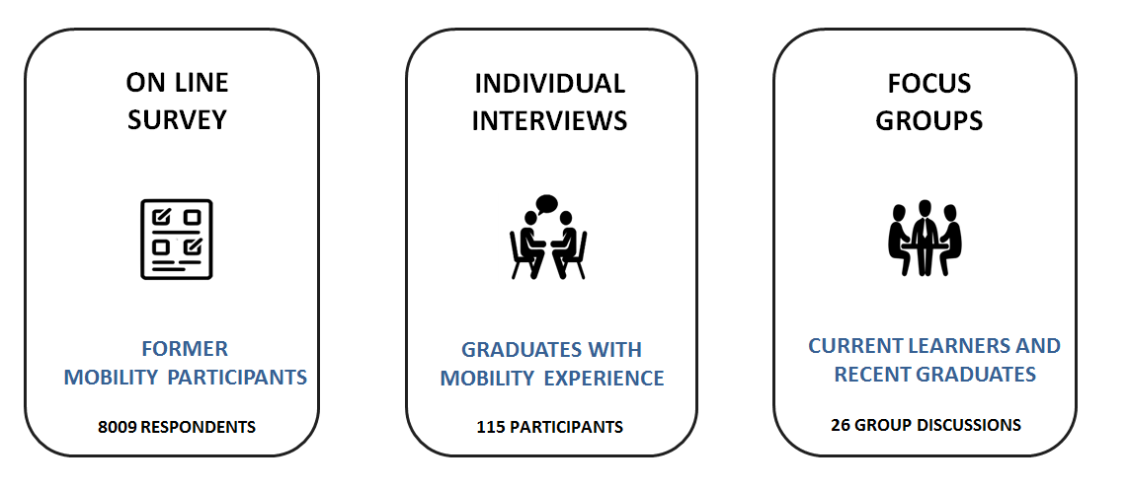
RESEARCH METHODS AND TARGET GROUPS

Slide 3
MOBILITY IMPACT ON PARTICIPANTS’ SKILLS
PERSONAL DEVELOPMENT PERCEIVED AS MOST IMPORTANT
NEW SKILLS – MOSTLY RELATED TO THE USE OF FOREIGN LANGUAGES (MOSTLY ENGLISH) AND SOFT SKILLS
OCCUPATIONAL SKILLS WERE LESS FREQUENTLY PERCEIVED (IF SO, THEY STEMMED MOSTLY FROM OBSERVED KNOW-HOW AND/OR TECHNOLOGICAL SOLUTIONS OF HOST COMPANIES)

Slide 4
Thanks to the placement I enhanced the following skills…

Slide 5
Thanks to the placement I enhanced the following skills…

Slide 6
Impact on Foreign Language Skills

Slide 7
Foreign Language Skills vs. Mobility Duration

Slide 8
MOBILITY IMPACT ON CAREER PATHS
NO DIRECT LINK BETWEEN TRANSNATIONAL PLACEMENT AND THE FINDING OF A JOB
THE LINK BETWEEN VET PLACEMENT DOMAIN AND CURRENT JOB CLAIMED BY MAJORITY OF GRADUATES
MANY OF PARTICIPANTS DECIDED TO CONTINUE THEIR EDUCATION (SCHOOLS/PROFESSIONAL COURSES/HEIs)
IMPORTANCE OF FORMAL RECOGNITION OF FOREIGN PLACEMENTS (CERTIFICATES)

Slide 9
My current employment or education is related to the field of my placement …

Slide 10
My Europass Mobility certificate was useful when looking for a job…

Slide 11
FURTHER CAREER AND EDUCATION PATHWAYS

Slide 12
MANTAINING PEOPLE TO PEOPLE CONTACTS

Slide 13
MANTAINING CONTACTS WITH HOST INSTITUTIONS

Slide 14
MOBILITY WEAKNESSES
INSUFFICIENT PREPARATION COURSES
TOO SHORT PERIOD OF A STAY ABROAD
LACK OF A MENTOR ABROAD / TO MUCH CONTROL OF MENTORS
CONTENTS OF PLACEMENTS NOT FULLY RELATED TO VET DOMAIN
SMALL AMOUNT OF TASKS DURING PLACEMENTS
MOBILITY STILL REMAINS AN EXCLUSIVE FORM OF THE TRAINING (AVAILABLE TO LIMITED NUMBER OF VET LEARNERS ONLY)

Slide 15
ANY QUESTIONs?
ANY DOUBTS?
CONTACT US!
MICHAŁ PACHOCKI
e-mail: mpachocki@frse.org.pl

